Slide 1

Chandigarh University
Department of Mathematics
B.Tech. CSE (Core/DS/IT/CC)
Semester-3
Subject Code:25MTT-202
Discrete Mathematics
Chapter:1.1.2
Dr. SARTAJ
DISCOVER . LEARN . EMPOWER

Slide 2

CO mappings

Slide 3

CO-PO mappings
Note: Degree of relevance/correlation: 1-Low, 2-Medium, 3-High, Blank or ‘- ‘- Nil

Slide 4
CO mappings

Slide 5
Topics Covered
Tautologies, Contradictions, Contingency
Conclusions
Video links
References

Slide 6
Tautologies, Contradictions, Contingency
Tautologies
A Tautology is a formula which is always T for every value of its propositional variables.
Contradictions
A Contradiction is a formula which is always F for every value of its propositional variables.
Contingency
A Contingency is a formula which has both some T and some F values for every value of its propositional variables.
ns

Slide 7
Tautologies, Contradictions, Contingency
Example of Tautologies:
Proposition [(A→B)∧ A]→B is tautology.
Example of Contradictions
Proposition (A∨B)∧[(¬A) ∧ (¬B)] is contradiction.
Example of Contingency
Proposition (A∨B)∧(¬A) is contingency.
ns

Slide 8
Tautologies, Contradictions, Contingency
As we can see every value of [(A→B) ∧ A]→B is "T", it is a tautology.
A | B | A → B | (A → B) ∧ A | [( A → B ) ∧ A] → B
T | T | T | T | T
T | F | F | F | T
F | T | T | F | T
F | F | T | F | T
ns

Slide 9
Tautologies, Contradictions, Contingency
As we can see every value of (A∨B)∧[(¬A)∧(¬B)] is F, it is a contradiction.
A | B | A ∨ B | ¬ A | (A ∨ B) ∧ (¬ A)
T | T | T | F | F
T | F | T | F | F
F | T | T | T | T
F | F | F | T | F
ns

Slide 10
Tautologies, Contradictions, Contingency
As we can see every value of (A∨B)∧(¬A) has both T and F, it is a contingency.
A | B | A ∨ B | ¬ A | (A ∨ B) ∧ (¬ A)
T | T | T | F | F
T | F | T | F | F
F | T | T | T | T
F | F | F | T | F
ns

Slide 11
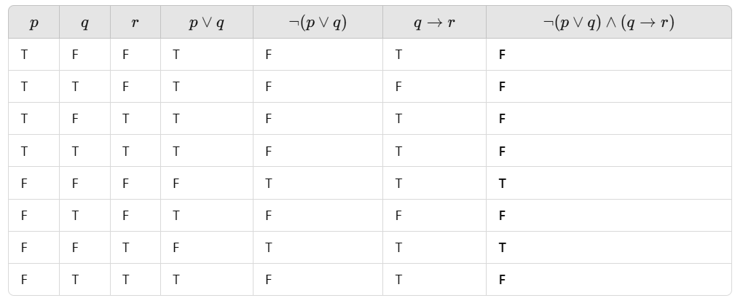
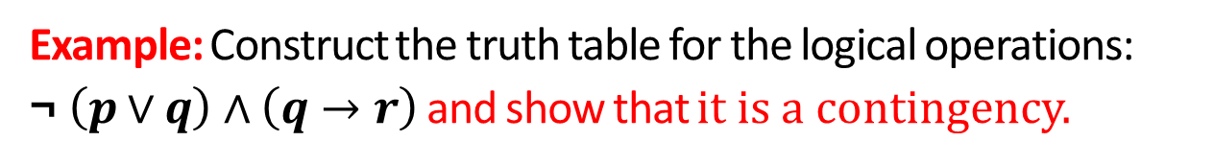
Tautologies, Contradictions, Contingency
Example: Construct the truth table for the logical operations:
¬ $\left(p∨q\right)∧\left(q→r\right)$ and show that it is a contingency.

Slide 12
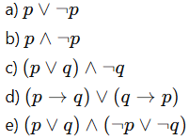
Activity
1. Construct the truth table for (p ↔ q) ∨ (¬p ∧ q) and classify the result.
2.Determine whether the following statements are tautologies or contradiction ns statements. Justify using truth tables.

Slide 13
Conclusion
Tautologies, Contradictions, Contingency have been discussed.
Related examples are presented.

Slide 14
Video Links
https://youtu.be/YYQfYBNlfZg?si=bzEHNN2yciHgzZjb
https://youtu.be/x4dr53P1Fm0?si=Xh6mSos07OhSBRCS
https://youtu.be/UN6Hd4UlrnM?si=aM2OinkT-XDvYiL8

Slide 15
References
Sr. No. | Author | Name of the Book | Publisher | Year of Publication
1 | Kenneth H. Rosen | Discrete Mathematics and Its Applications | McGraw-Hill | 2019
2 | C. L. Liu | Elements of Discrete Mathematics | McGraw-Hill | 1996
3 | J. P. Tremblay, R. Manohar | Discrete Mathematical Structures with Applications to Computer Science | Tata McGraw Hill | 2001
4 | Kolman, Busby, Ross | Discrete Mathematical Structures | PHI | 2001
5 | Narsingh Deo | Graph Theory with Applications to Engineering and | PHI | 2017

Slide 16
Thanks!!!

